Slide 1


Project 5 NPOI Capstone: Final Prototype
•Bradley Kingsley
•Dustin Haines
•Son Nguyen

Slide 2
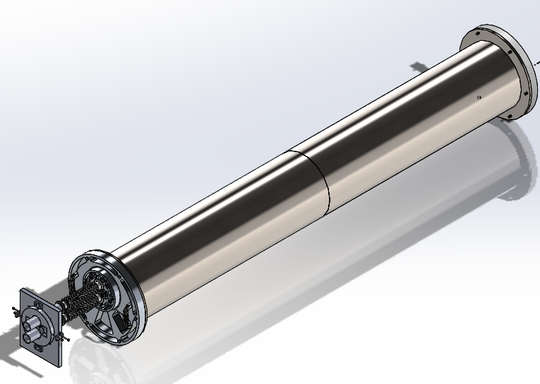
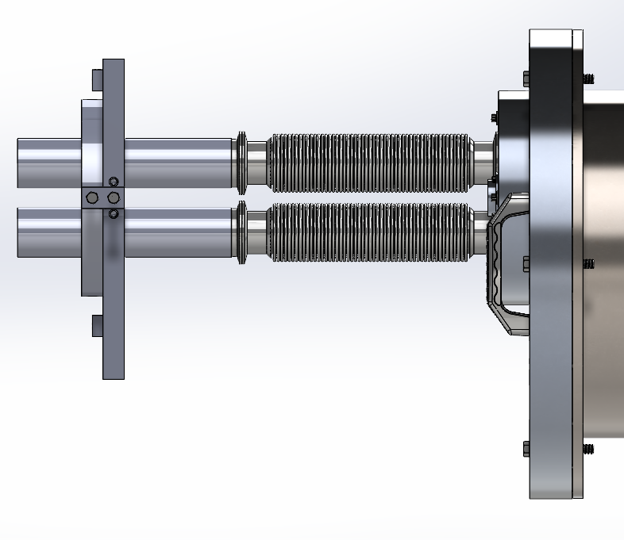
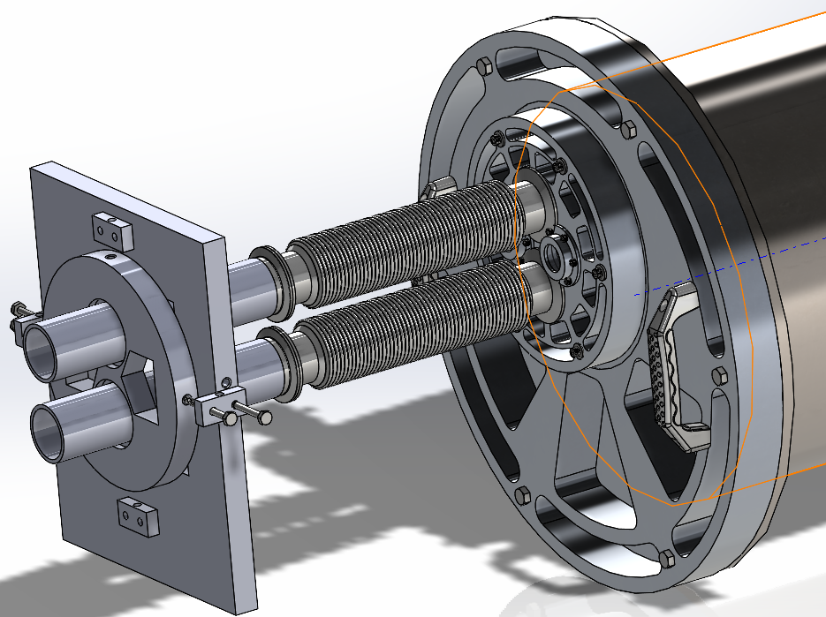
Key Principle Of Designs
Consists of 3 different parts: snoot adjuster, Flexible Snoot, and front and rear seal plates.
Front and rear seal plate are connecting with the FDL tank.
Figure 1. Final Assembly
Figure 2. Side view
Figure 3. Front FDL assembly

Slide 3
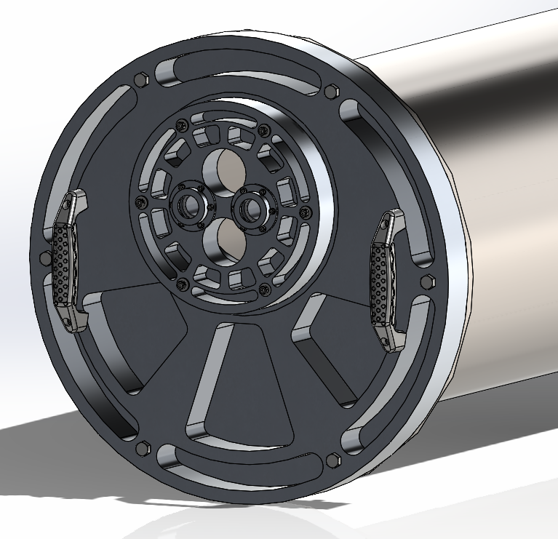
Front Seal Plates
Bare Plate Weight: 30.51 LBS
Bare Snoot Plate Weight: 6.35 LBS
6061-T651 Aluminum
Pressure Acting: 14.7 psi
Different O-rings and bolt-patters for windows and snoot mount
Attachments:
  Metrology Window
  Window Hat
  Handles
Figure 4. Front Seal Plates

Slide 4
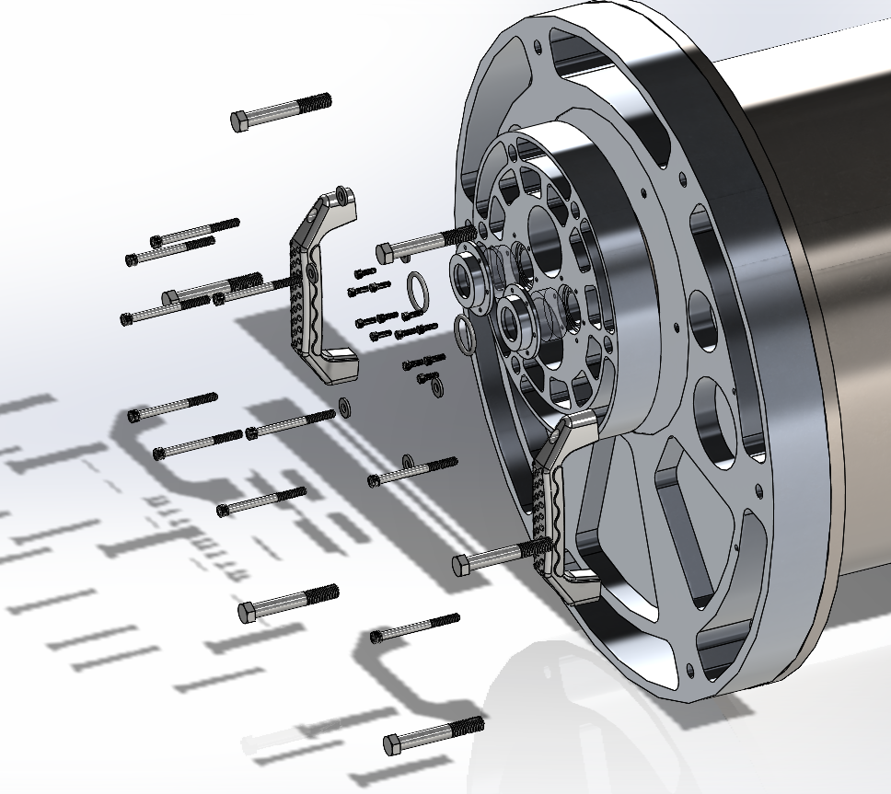
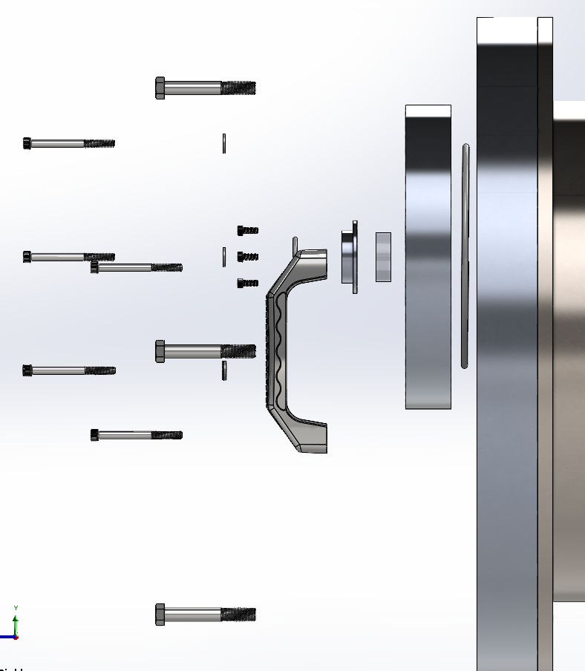

Slide 5
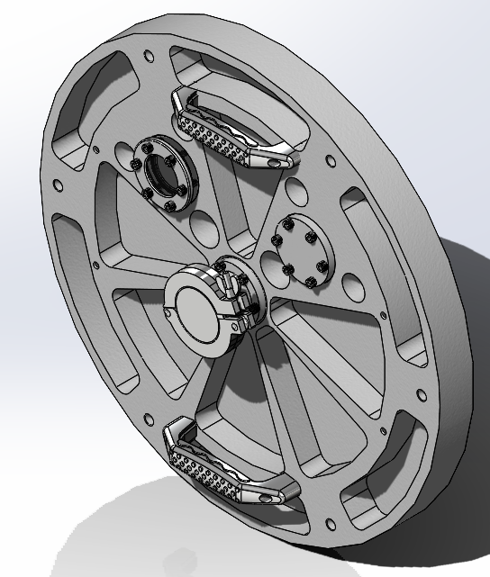
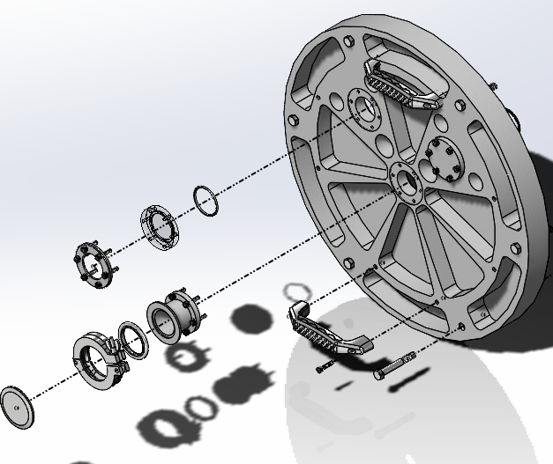
Rear Seal Plates
Bare Plate Weight: 32.5 LBS.
6061-T651 Aluminum
Pressure Acting: 14.7 psi
All attachments have the same bolt pattern and O-ring.
Attachments:
  Vacuum Window
  Blanking Plate
  KF50 Vacuum Attachment Flange (Kurt J. Lesker Flange Style)
  Grab Handles

Slide 6
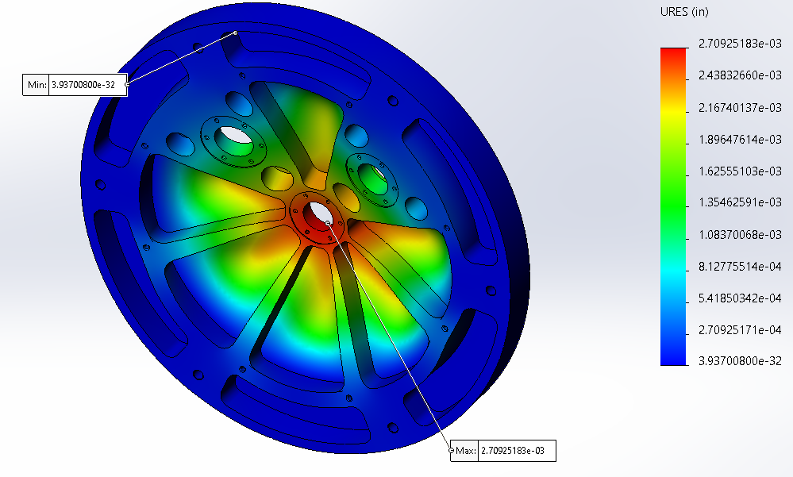
Rear Seal Plate Analysis
P=14.7 PSI
Fixed Geometry on Back Side bolt hole edge for simulation.
Pressure ONLY acting on center 16" Diameter Circle
P=22.3 PSI on Spot Face due to force acting on annulus.
Maximum Deflection=0.00271"

Slide 7
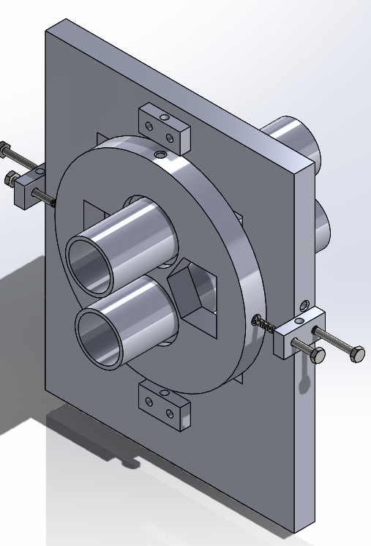
Snoot Adjuster
Rectangle weight: 17.68 LBS. Height: 15 inches. Width: 12 inches.
Round shaft weight: 6.23 LBS. Diameter: 9 inches.
Key design:
  The adjuster can be moved up, down, left, right within 1 inch.
  The adjuster will be able to withstand the vacuum force of 45x2 psi that apply on the snoot during the vacuum process.
  Both the adjuster and snoot must be kept in place during standby.

Slide 8
References
•[1] 'The Importance of Choosing the Correct Material for Vacuum O-Rings and Vacuum Seals'. Apple Rubber. [OnlineAccess]. https://www.applerubber.com/hot-topics-for-engineers/the-importance-of-the-correct-material-for-vacuum-o-rings-and-vacuum-seals/
•[2] J.A. Clark III , J. Murphy, L. Ha, J. P. Walton , J. Howard, J. T. Armstrong, G. C. Gilbreath , R. B. Hindsley , and T. A. Pauls. 'Alignment of vacuum feed stations on the Navy Prototype Optical Interferometer'. [OnlineAccess]. https://apps.dtic.mil/sti/pdfs/ADA477246.pdf
•[3] 'Vacuum Chambers and Optical Equipment'. Imperial Machine & Tool CO. [OnlineAccess]. https://www.imperialmachine.com/vacuum-chambers
•[4] 'The long-stroke MROI vacuum delay lines from concept to generation' [OnlineAccess]. https://www.researchgate.net/publication/237371110_The_long-stroke_MROI_vacuum_delay_lines_from_concept_to_production
•[5] “Kurt J. Lesker Company,” www.lesker.com. https://www.lesker.com/index.cfm (accessed Oct. 11, 2022).
•[6] “Parker Engineering Your Success Motion Control Technology,” Parker Hannifin Corporation, 2020. https://www.parker.com/portal/site/PARKER/menuitem.b90576e27a4d71ae1bfcc510237ad1ca/?vgnextoid=c38888b5bd16e010VgnVCM1000000308a8c0RCRD&vgnextfmt=EN
•[7] “Fittings, Flanges, and Hardware | Ideal Vacuum,” www.idealvac.com. https://www.idealvac.com/Fittings-and-Flanges/ct/2 (accessed Oct. 11, 2022).
•[8] “Vacuum Fittings and Flanges,” www.newport.com. https://www.newport.com/c/vacuum-flange-components (accessed Oct. 11, 2022).
•[9] “Optical Imaging | Laser Optics | Edmund Optics,” www.edmundoptics.com. https://www.edmundoptics.com/
•[10] “Carr,” McMaster. [Online]. Available: https://www.mcmaster.com/. [Accessed: 11-Oct-2022].
•[11] “Thorlabs, Inc. - your source for fiber optics, laser diodes, optical instrumentation and polarization measurement & control,” Thorlabs, Inc. - Your Source for Fiber Optics, Laser Diodes, Optical Instrumentation and Polarization Measurement & Control. [Online]. Available: https://www.thorlabs.com/. [Accessed: 11-Oct-2022].
•[12] “Aluminum supplier,” Aluminum Supplier | Bar, Sheet, Plate, Tube, Pipe, Shape. [Online]. Available: https://www.industrialmetalsupply.com/Products/Metals/aluminum?gclid=EAIaIQobChMIp7f_rKrZgIV9QetBh3t0QAOEAAYASAAEgKFvPD_BwE. [Accessed: 11-Oct-2022].
•[13] “Home,” Alaska Rubber Group. [Online]. Available: https://www.alaskarubbergroup.com/. [Accessed: 11-Oct-2022].
•[14] Www.htcvacuum.com 日揚科技股份有限公司 |, “Vacuum components suppliers: Vacuum products manufacturer: Vacuum Chamber Kits - HTC Vacuum,” Vacuum Components Suppliers| Vacuum Products Manufacturer | Vacuum Chamber kits - Htc vacuum. [Online]. Available: https://www.htcvacuum.com/en-global/vacuum-components?gclid=EAIaIQobChMIrKbp4arZ-gIV-BetBh3FDAJXEAAYASAAEgKxi_D_BwE. [Accessed: 11-Oct-2022].
•[15] “Socket Head Cap Screws Dimensions & Specs | AFT Fasteners,” www.aftfasteners.com. https://www.aftfasteners.com/socket-cap-screws-dimensions-and-mechanical-properties/ (accessed Oct. 11, 2022).

